Slide 1
Erie County Technical School Capital Outlay Funding Formula
Millcreek Township School District Proposed Formula Change

Slide 2
History
ECTS was initially owned by the Public School Building Authority until deeded over to the 19 School Districts around 1968.
Capital formula outlay was originally derived from 24 P.S. 24-2574, which applies to buildings owned by the State Public School Building Authority.
The operational formula was changed several years ago to reflect a rolling 3 year average of student population.
Presently there are 6 Tech schools (out of the 11 responses we received) who have changed both of their operational and capital formulas from the original formula as shown above to a more realistic, reasonable formula which is similar to our operational formula.
Districts agreed to develop architectural and engineering designs and allocate costs based on existing capital outlay formula.
Districts agreed not to spend over $32.5M.

Slide 3
Existing Formula - $32,500,000 Total Cost
District | *2017 MV | Percent Share | Cost
Fairview | 831,926,407.00 | 8.20% | 2,666,240.98
Fort Leboeuf | 1,344,642,761.00 | 13.26% | 4,309,445.64
General Mclane | 913,518,428.00 | 9.01% | 2,927,735.25
Girard | 474,308,018.00 | 4.68% | 1,520,109.79
Harbor Creek | 932,713,112.00 | 9.20% | 2,989,252.29
Iroquois | 227,822,014.00 | 2.25% | 730,146.78
Millcreek | 3,656,701,658.00 | 36.06% | 11,719,363.30
North East | 542,515,700.00 | 5.35% | 1,738,708.59
Northwestern | 412,611,784.00 | 4.07% | 1,322,379.52
Union City | 253,819,805.00 | 2.50% | 813,467.10
Wattsburg | 550,142,197.00 | 5.43% | 1,763,150.75
Total | 10,140,721,884.00 | 100.00% | 32,500,000.00
*Same values used to allocate architect costs based on the DCED’s State Tax Equalization Board Market Values

Slide 4
Proposed Formula – First $20,312,500 Spent
District | Percent Share | Cost
Fairview | 8.20% | 1,666,400.61
Fort Leboeuf | 13.26% | 2,693,403.53
General Mclane | 9.01% | 1,829,834.53
Girard | 4.68% | 950,068.62
Harbor Creek | 9.20% | 1,868,282.68
Iroquois | 2.25% | 456,341.74
Millcreek | 36.06% | 7,324,602.06
North East | 5.35% | 1,086,692.87
Northwestern | 4.07% | 826,487.20
Union City | 2.50% | 508,416.94
Wattsburg | 5.43% | 1,101,969.22
Total | 100.00% | 20,312,500.00
The total of $20,312,500 will be distributed based on the existing formula. This total is 63% of the total maximum cost of $32,500,000.

Slide 5
Proposed Formula – Remaining $12,187,500
District | Percent Share | Cost
Fairview | 4.13% | 503,263.84
Fort Leboeuf | 10.24% | 1,247,788.65
General Mclane | 8.63% | 1,052,378.18
Girard | 9.39% | 1,144,079.18
Harbor Creek | 8.90% | 1,085,128.54
Iroquois | 4.48% | 545,839.30
Millcreek | 20.96% | 2,554,527.95
North East | 9.80% | 1,194,296.40
Northwestern | 8.92% | 1,087,311.90
Union City | 5.83% | 710,682.77
Wattsburg | 8.72% | 1,062,203.29
Total | 100.00% | 12,187,500.00
The total of $12,187,500 will be distributed based on a participation trend from the last 15 years. This total is 37% of the total maximum cost of $32,500,000.

Slide 6
Proposed Formula Compared to Existing Formula
District | Existing Formula | Proposed Formula | Existing Formula | Proposed Formula | Variance
Fairview | 8.20% | 6.68% | 2,666,240.98 | 2,169,664.45 | 496,576.53
Fort Leboeuf | 13.26% | 12.13% | 4,309,445.64 | 3,941,192.18 | 368,253.46
General McLane | 9.01% | 8.87% | 2,927,735.25 | 2,882,212.71 | 45,522.54
Girard | 4.68% | 6.44% | 1,520,109.79 | 2,094,147.80 | -574,038.01
Harbor Creek | 9.20% | 9.09% | 2,989,252.29 | 2,953,411.22 | 35,841.07
Iroquois | 2.25% | 3.08% | 730,146.78 | 1,002,181.04 | -272,034.26
Millcreek | 36.06% | 30.40% | 11,719,363.30 | 9,879,130.01 | 1,840,233.29
North East | 5.35% | 7.02% | 1,738,708.59 | 2,280,989.27 | -542,280.68
Northwestern | 4.07% | 5.89% | 1,322,379.52 | 1,913,799.10 | -591,419.57
Union City | 2.50% | 3.75% | 813,467.10 | 1,219,099.71 | -405,632.61
Wattsburg | 5.43% | 6.66% | 1,763,150.75 | 2,164,172.51 | -401,021.76
Total | 100.00% | 100.00% | 32,500,000.00 | 32,500,000.00 | 0.00

Slide 7
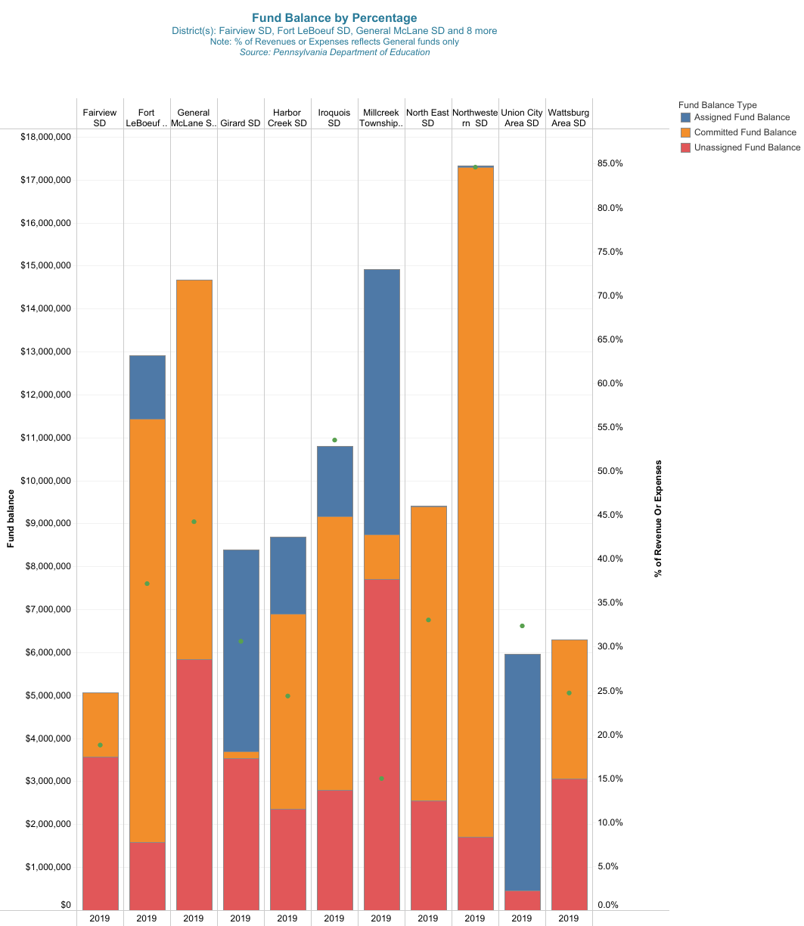
As of the 2018-19 SY, Millcreek has the lowest fund balance (as a percent of expenditures) compared to all the participating districts.

Slide 8
Proposed Formula Change Conclusion
Millcreek is proposing to adjust the funding formula because our average participation trend for the past 15 years is 21% and we have less of a savings compared to other districts.
Millcreek is proposing to adjust the funding formula related to the current ECTS renovation and pay 30.4% of the total cost.
The cost of the current renovation must not exceed $32.5M, which is the total all Districts already agreed upon.
The ECTS Articles of Agreement for Operation capital outlay formula will be changed to a District participation formula based on the prior 15 years of operation upon this projects conclusion.

Slide 9
Timeline
Today we are discussing the proposed capital outlay formula.
In January 2021, an agenda item will be requested for a JOC vote on a proposed capital outlay formula.
In January/February 2021, Districts vote regarding proposed capital outlay formula.

