Slide 1

The Product
Business Plan Presentation
Erie County Vocational-Technical School Foundation
January 25, 2018

Slide 2
Market Analysis
Target Market:
  Local area (technical school, school district, county, region or workforce region), that wants to “web-enable” their business-education partnership “matchmaking” efforts and better measure their outcomes and impact, whether they have an existing partnership or not.
Market Potential:
In-Depth Interviews with prospects
  Software demonstration followed by questions related to features and benefits, price sensitivity and interest
10% of actual numbers | Workforce Investment Areas | Counties | School Districts | Chambers of Commerce
Regional | 11 | 31 | 273 | 61
National | 53 | 308 | 1.300 | 300

Slide 3
Products/Services
Software Service
  purchase a Career Street website license, and customize the Career Street website to meet individual local area needs and/or support existing business-education partnership activities.
Comprehensive Program Affiliate
  a blended “package” of services including:
    Start-up schedule
    Job descriptions and guidance to assemble your local project team
    Customization of local website pages to serve your local community
    Marketing and communication plan and materials to help spread the word
    Model budgets
    Benchmarks and outcome measures
    Sustainability plan, grant writing support and fundraising assistance
Technical Assistance and Consulting
  to establish a local area business-education partnership program if one does not already exist or to enhance existing programming or use of the website

Slide 4
Marketing Plan
Projected Sales
Regional Workforce and Career Education Trade Associations
  Conferences
  Educational Programs
National Workforce and Career Education Trade Associations
  Conferences
  Educational Programs
Base Cost* | Year 1 | Year 2 | Year 3
New Websites $5,000 | 4 | 6 | 7
Renewal Websites $2,000 | 0 | 3 | 9
New Programs $15,000 | 3 | 3 | 3
Renewal Programs $5,000 | 0 | 3 | 3
*Plus “Tier Size” Premium

Slide 5
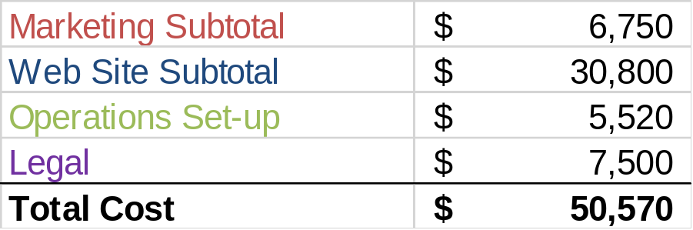
Financial Analysis
Start Up Costs:
Cash flow is positive by end of Year 1, profitable in Year 2 if sales projections are met
Most costs are variable

Slide 6
Recommendations
Copyright all existing Career Street materials (and all those developed)
Hire the Career Street Executive Director as an employee of the Foundation
Be prepared to invest in growth if demand exceeds projections (e.g. big city or entire state)
Continually monitor environment for competitive threats (Career Zone or others)

Slide 7

Questions/Discussion

