Slide 1


Erie County Technical School
Facility & Energy Efficiency Improvement Program
Dave Kramer, Kirby Slear, & Tim Roos
October 22, 2015

Slide 2
Purpose
Why did ECTS want to explore Performance Contracting?
* To determine if a more financially attractive opportunity exists through an ESCO partnership *

Slide 3




Why Performance Contracting?
Performance Contracting Overview
  Alternative to traditional construction (Act 39 of 2010)
  Make needed facility improvements
  Turn-key solution
  Variety of financing options
Improved Construction Experience
  Drives energy and/or cost savings
  Budget certainty (no change orders)
  ESCO is single source of accountability
    Responsible for bidding process
    Handles design & installation
  Ensures quality installation (avoid issues of low-bid)
  Improved process leads to faster installation / completion

Slide 4

Partnership
Engagement with Administration
  Working with administration several months
  Collaboration on ECTS needs, goals, and parameters
  Co-development of technical solution with Mr. VonVolkenburg
Partnership Approach
  Top Priorities:
    1) Help ECTS achieve greatest overall value on project
    2) Focus in areas of expertise & positive impact
Project Drivers
  Reduced financial impact
  Energy efficiency
  Ease of maintenance
  Student enrichment opportunities

Slide 5
Accomplished to Date
Several Site Visits
  Engineering
  Construction
  Mechanical
  Electrical
  Controls
  Roofing
  Windows
  Plumbing
Utility & Energy
  Data gathering
  Energy baseline development
  Savings projections
Conceptual Design
  Engineering & design
  Scope of work
  Equipment counts
  Cost projections
  Installation plan
Comprehensive Solution

Slide 6
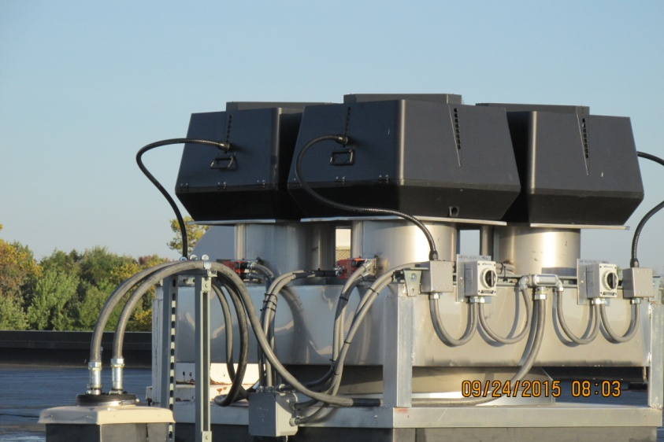
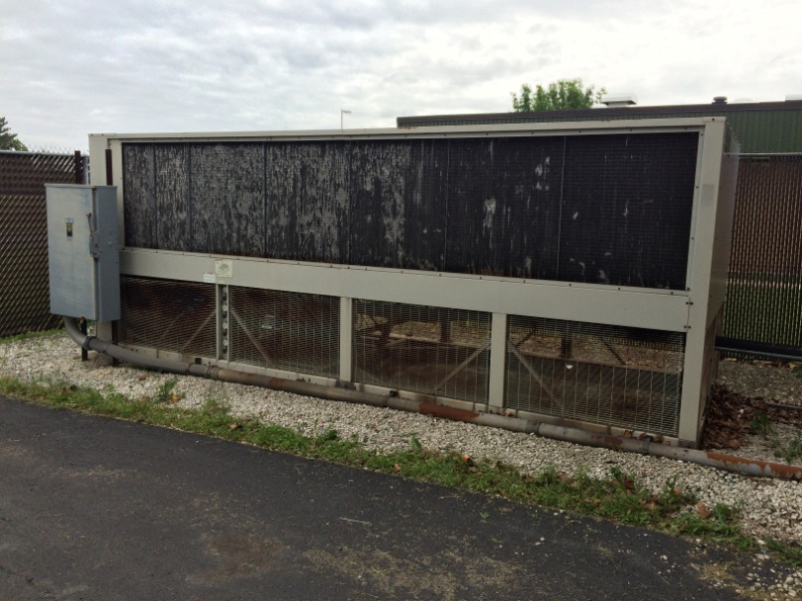
Proposed Solution
Heating System
  Non-condensing boilers
  Cost savings outweighed limited energy savings
  Retains recent investment in flue system
Cooling System
  Packaged / self contained chiller
  Compressors track load demand
  Leads to equipment longevity & reduced maintenance

Slide 7
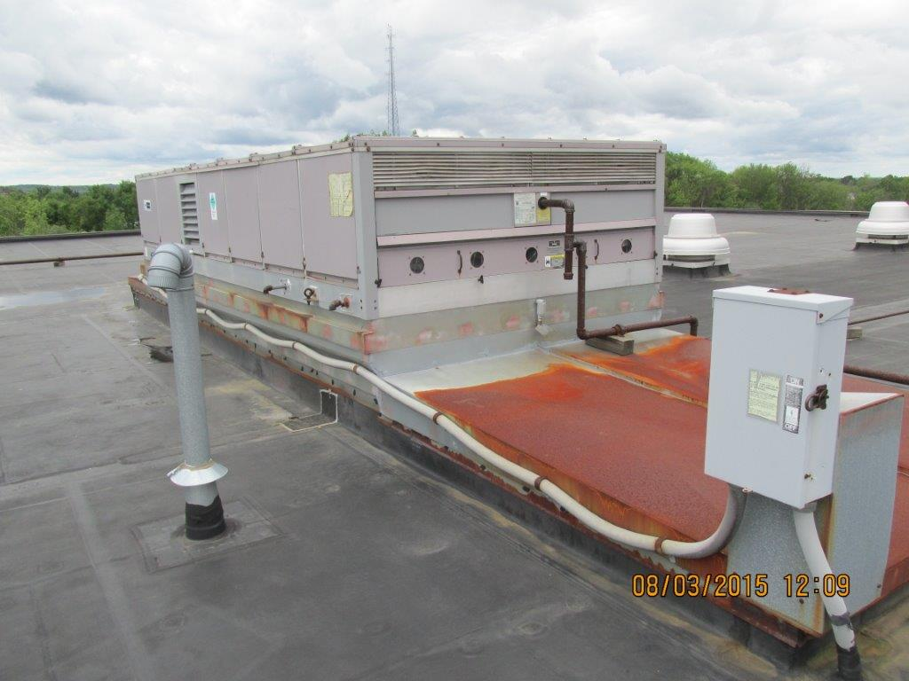
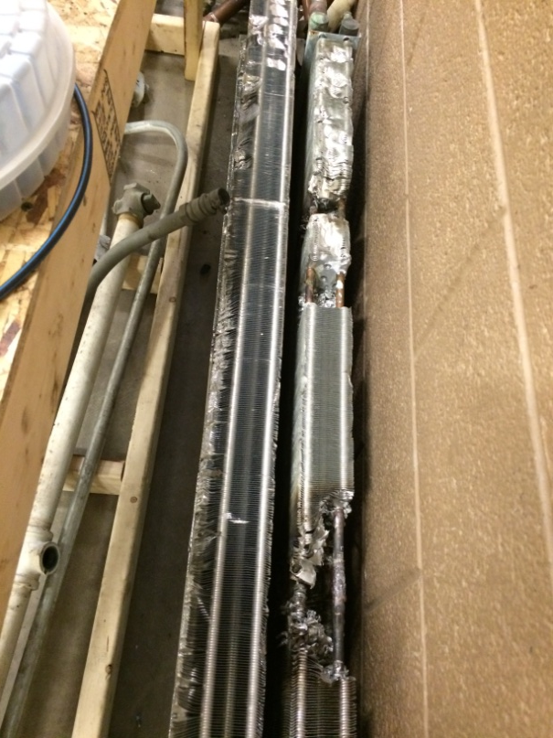
Proposed Solution
Rooftop Units
Unit Ventilators
Business Office HVAC
Skill Center HVAC
  Multi-zone units no longer made
  Replace with VAV system
  Improves student comfort

Slide 8
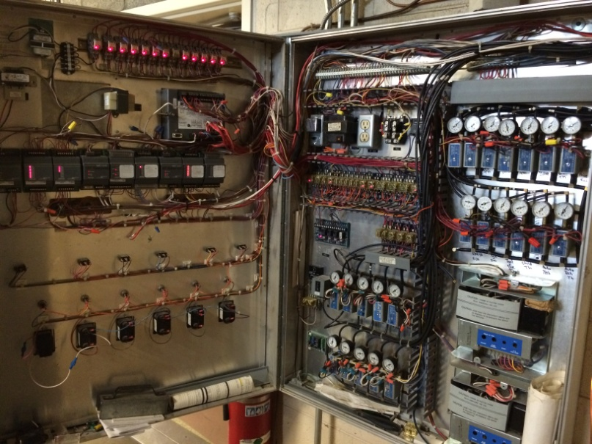
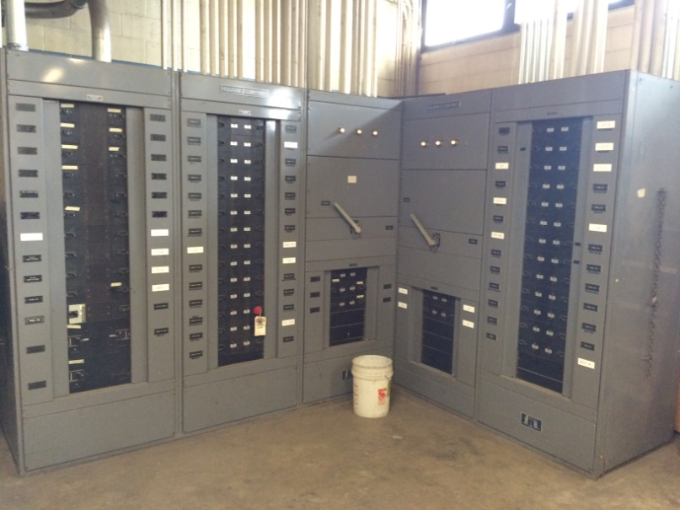
Proposed Solution
Controls System
  Individual zone control
  Improved comfort & efficiency
  Remote access capability
  Ease of maintenance
  Open system for service
Electrical System
  Focused on true needs
  Service & wiring appears to be in good condition
  Replacing main distribution panel, sub-panels, & transformers
  Significant cost savings

Slide 9
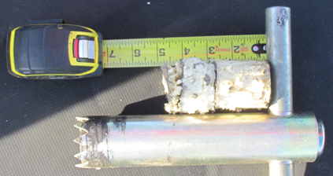
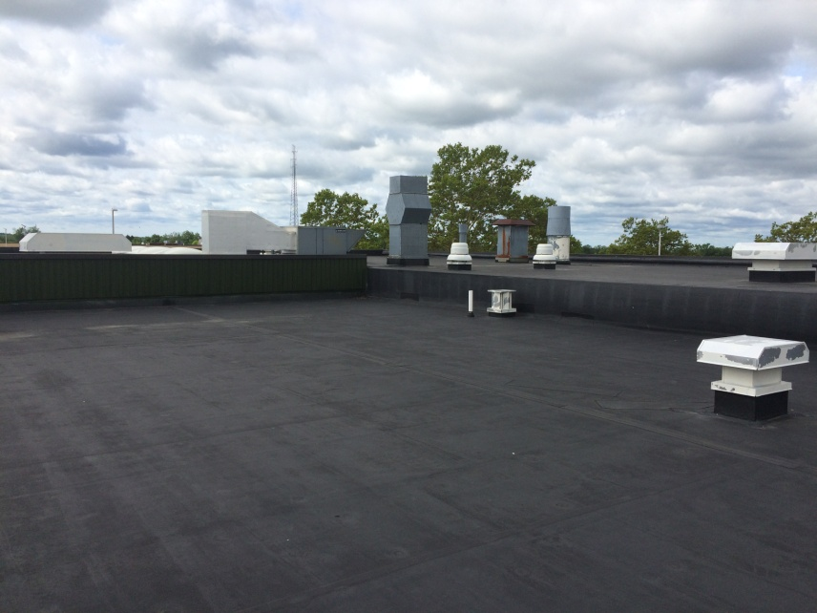
Proposed Solution
Roofing System
  From 1993 renovation
  Generally good condition
  Minimal leaking or maintenance
  Insulation dry; core sample taken
  Urethane coating to extend life
  Significant cost savings
Windows
  Focused on true needs
  Replace remaining single pane windows
  Significant cost savings
Additional Offerings

Slide 10

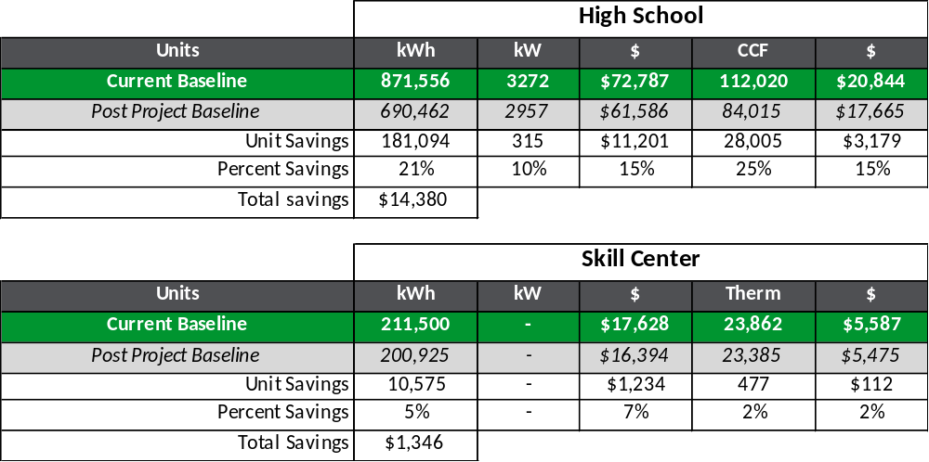
Utility Analysis

Slide 11

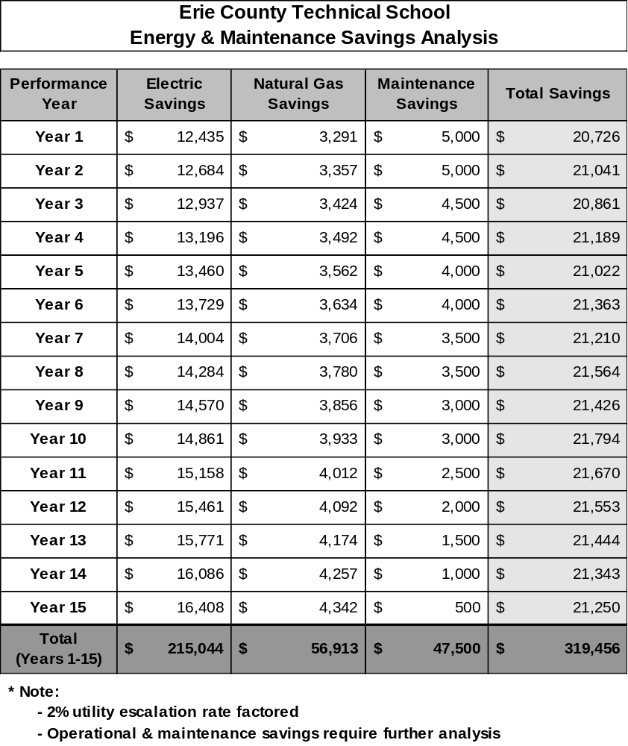
Savings Analysis – Cash Flow

Slide 12
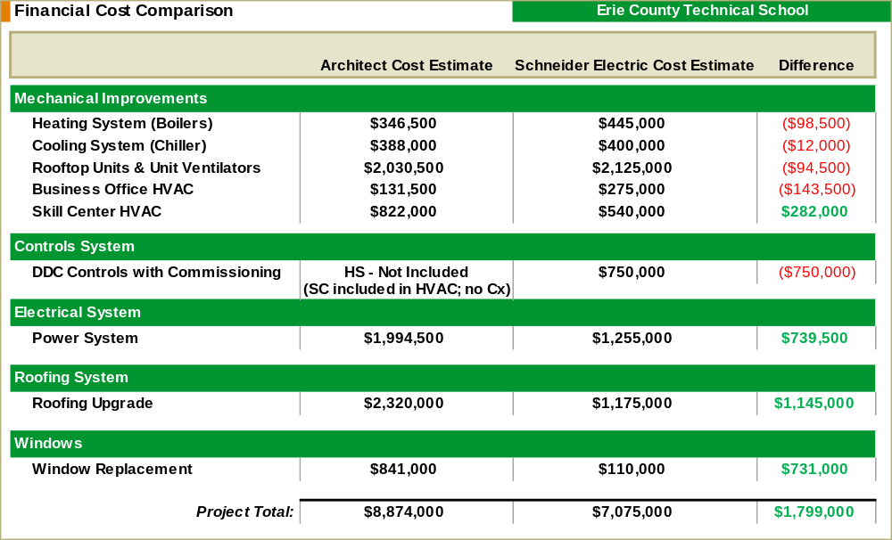
Financial Cost Comparison

Slide 13
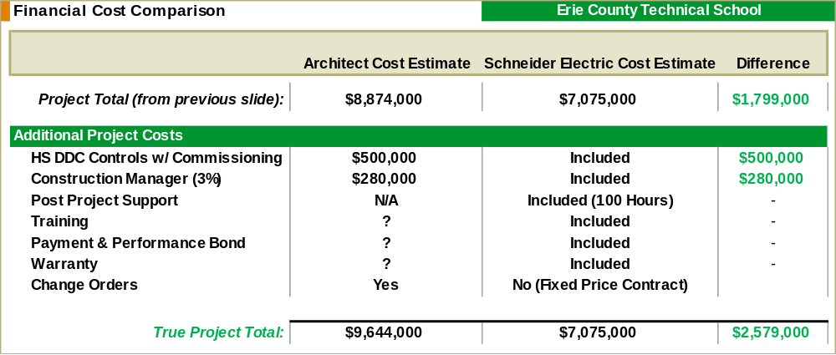
Financial Cost Comparison

Slide 14

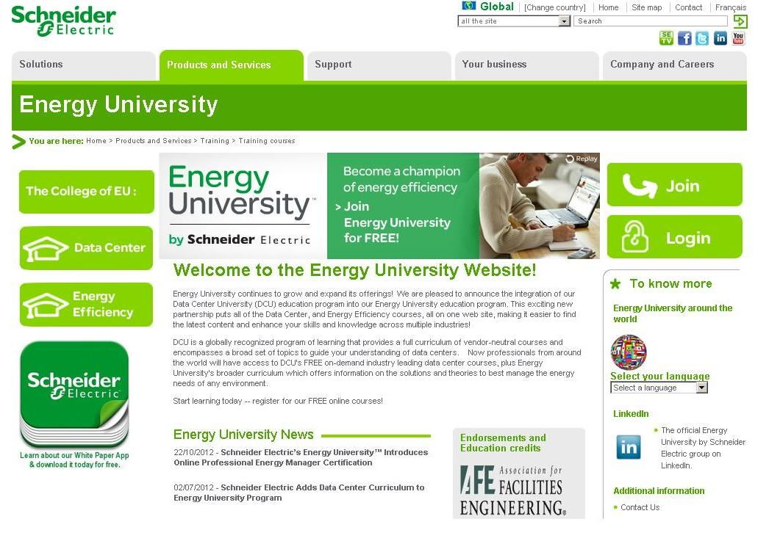
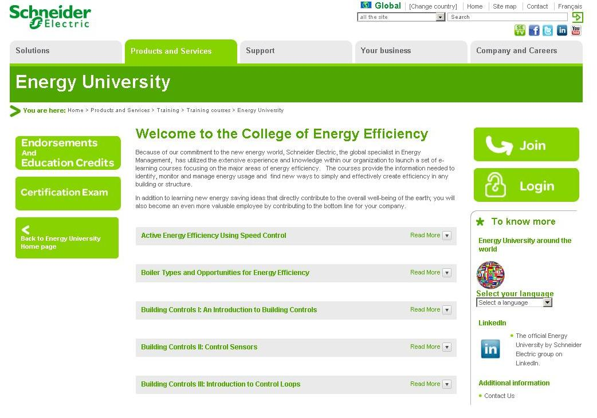
Student Engagement & Enrichment
Student Enrichment Opportunities
  Job shadowing
  Career fair participation
  ‘Community Night’ support
  STEM offerings
  Earth Day activities
  ‘Green Team,’ recycling, environmental, engineering club support
  Community messaging
  Pre & post savings data
  Awareness signage & dashboards
  My Energy University curriculum
  Flexibility with additional ideas

Slide 15
Key Takeaways
Original Purpose: Does a more financially beneficial opportunity exist?
Why Schneider Electric?
  Significant financial cost reduction ($2,500,000⁺)
  Provides budget certainty
  Collaborative design with ECTS
  Quality installation with post project support
  Fastest process to completion
  Extensive K-12 & Technology Center experience
  Eliminate risk from Investment Grade Audit

Slide 16
What questions do you have?
Contact Info:
Dave Kramer
Schneider Electric
412-680-5743
david.kramer@schneider-electric.com

