Slide 1
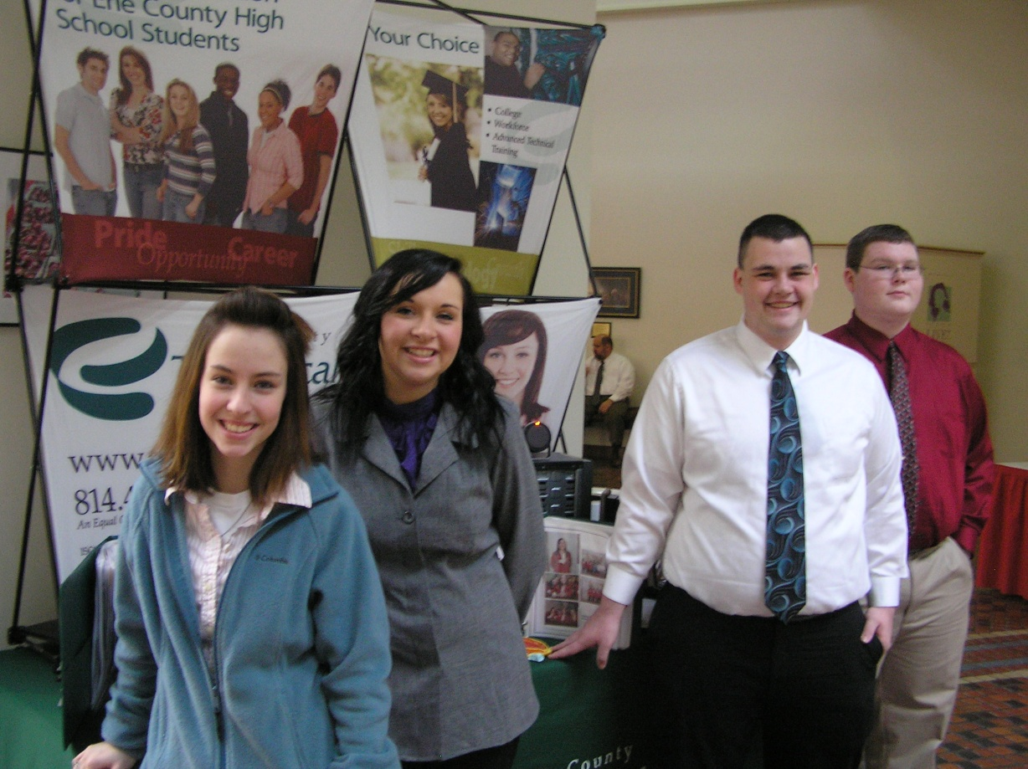
CTE Week – Harrisburg, PA
February 7-9, 2011

Slide 2
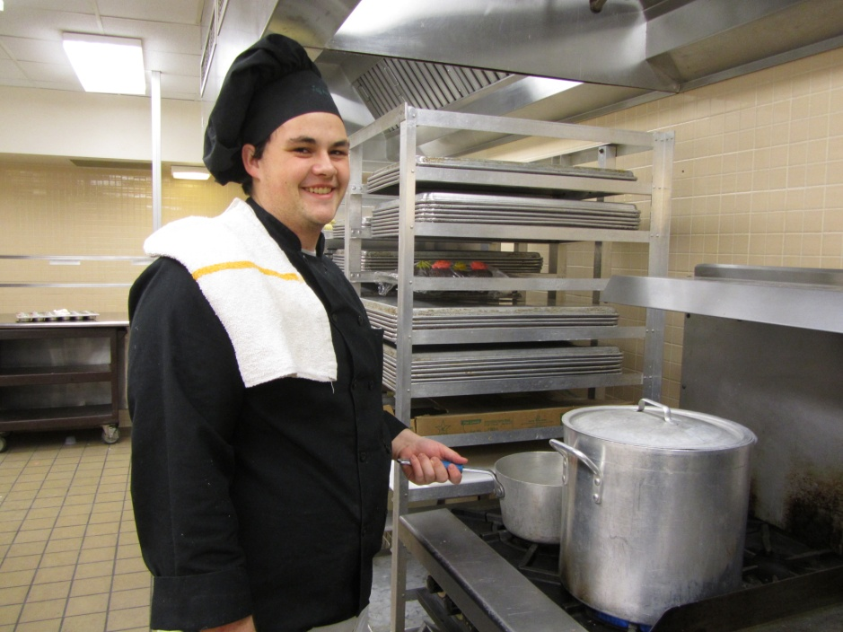
Your ECTS Student Representatives . . .
“For me, it was the desire to experience the creativity of Culinary Arts that brought me to the Erie County Technical School. I plan to attend Johnson & Wales to earn a bachelor’s degree in Food Service Management. Then I want to open my own restaurant and start my own cooking show.”
Jeff Harris
Culinary Arts
McDowell HS Senior

Slide 3
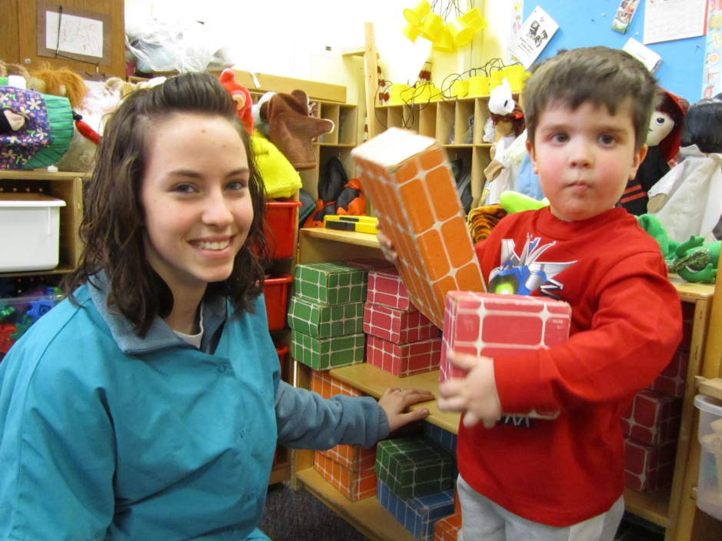
Your ECTS Student Representatives . . .
“The Early Childhood Education Program is a dream come true for me. Through our Tech Tikes Preschool, I have found that I love working with children. After graduation, I plan to go to college for Special Education and
Elementary Education or Social Work.”
Joelene Dieter Early Childhood Education
Fairview HS Junior

Slide 4
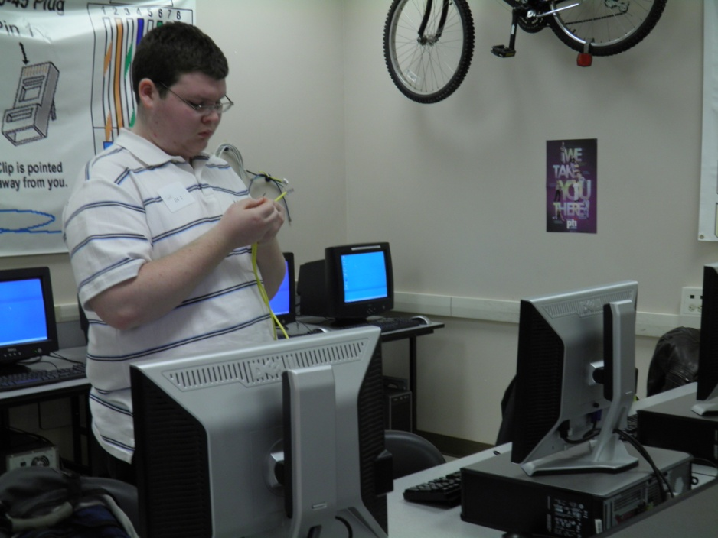
Your ECTS Student Representatives . . .
“My decision to attend ECTS was the best decision of my school career. I get to spend time every day working in a field that I enjoy and I also learn how the skills that I am developing will apply to a future career. I am planning to attend PTI and earn an Associate Degree in Network Administration/Computer Forensics.”
Steven Pavolko
Networking Technologies
Northwestern HS Senior

Slide 5
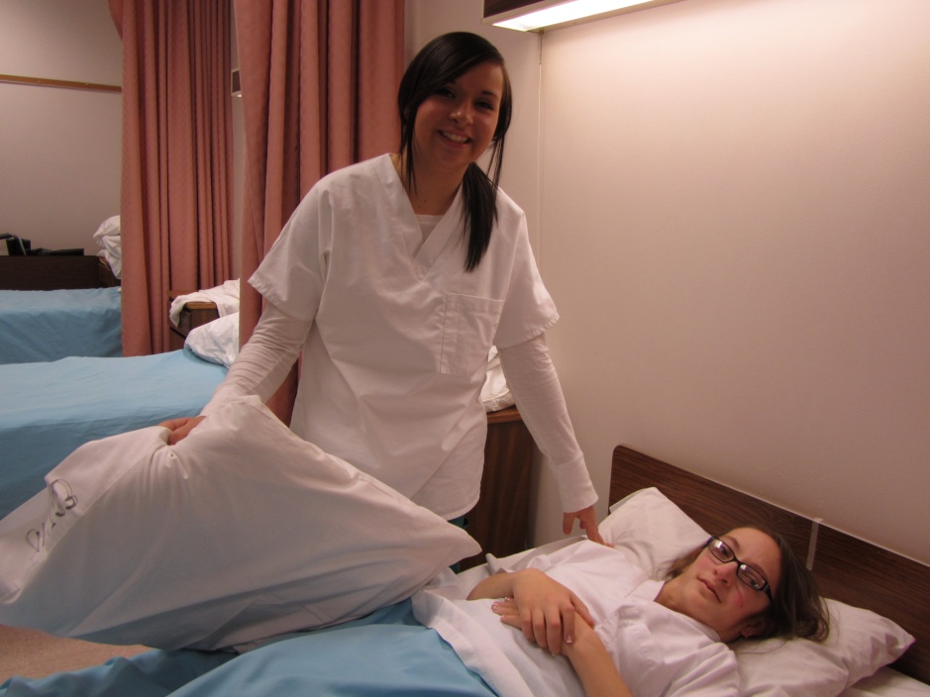
Your ECTS Student Representatives . . .
“Most of my memories of my grandmother are those of her lying ill in a hospital bed. At an early age, I knew I wanted a career in the medical field where I could help people who were in my grand-mother’s situation. Now I am well on my way to becoming a registered nurse. Because of ECTS, I am confident and prepared for the beautiful future that lies ahead of me.”
Britteny Roskie
Health Assistant Program
North East Junior

Slide 6
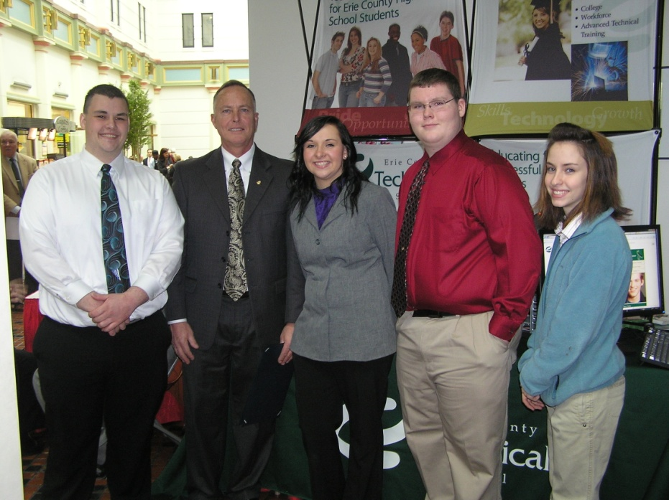
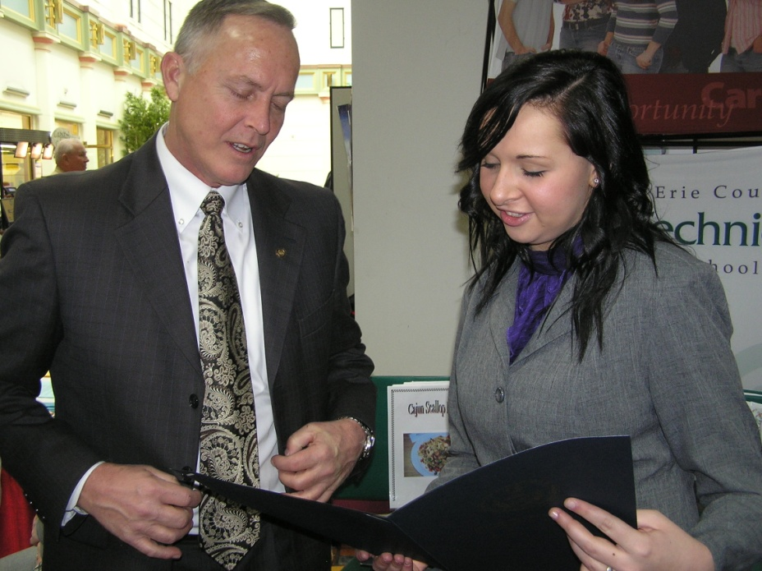
Meeting Rep. Curt Sonney

Slide 7
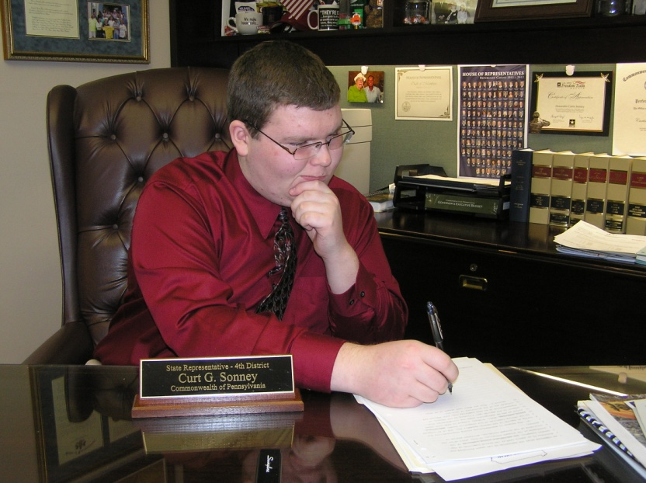
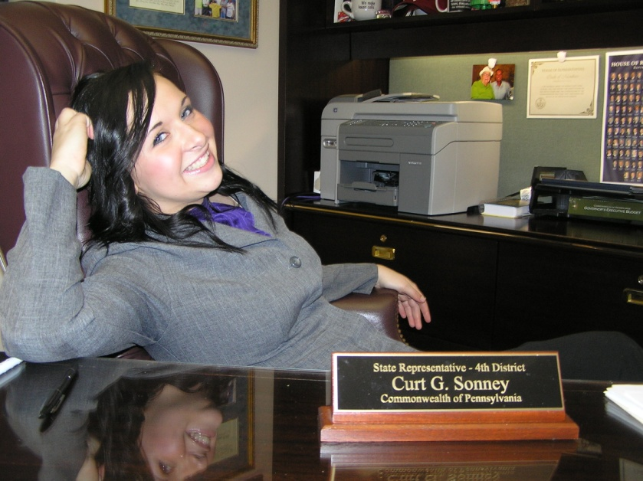
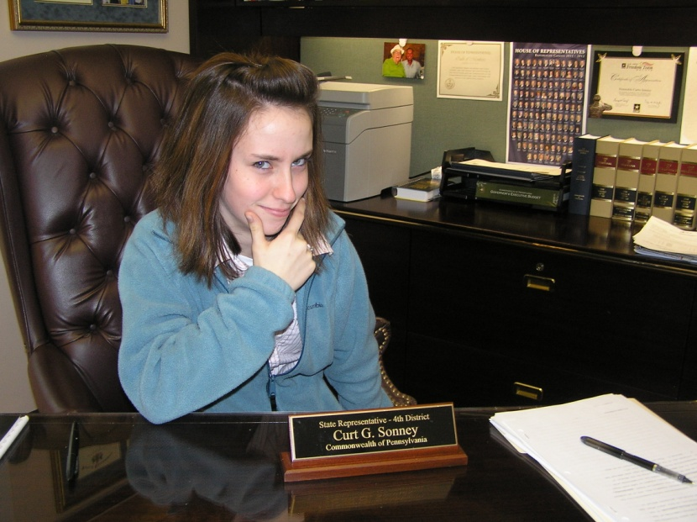
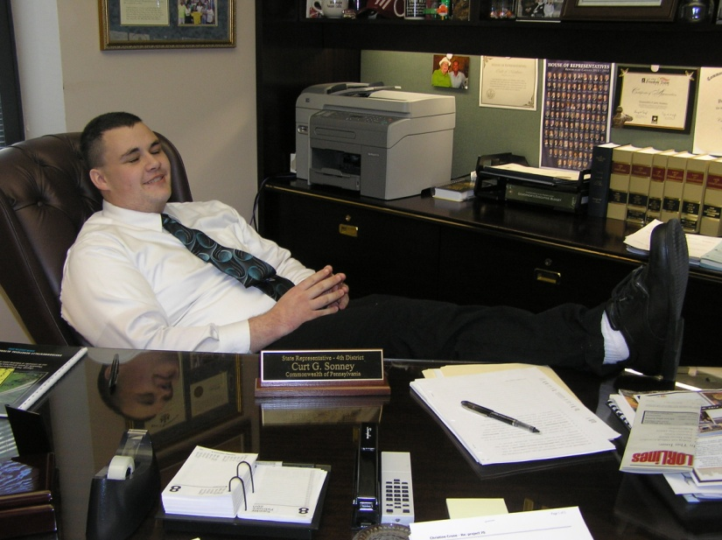
And Filling in For Him

Slide 8
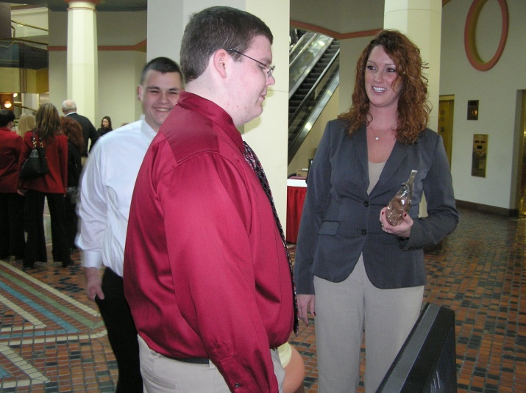
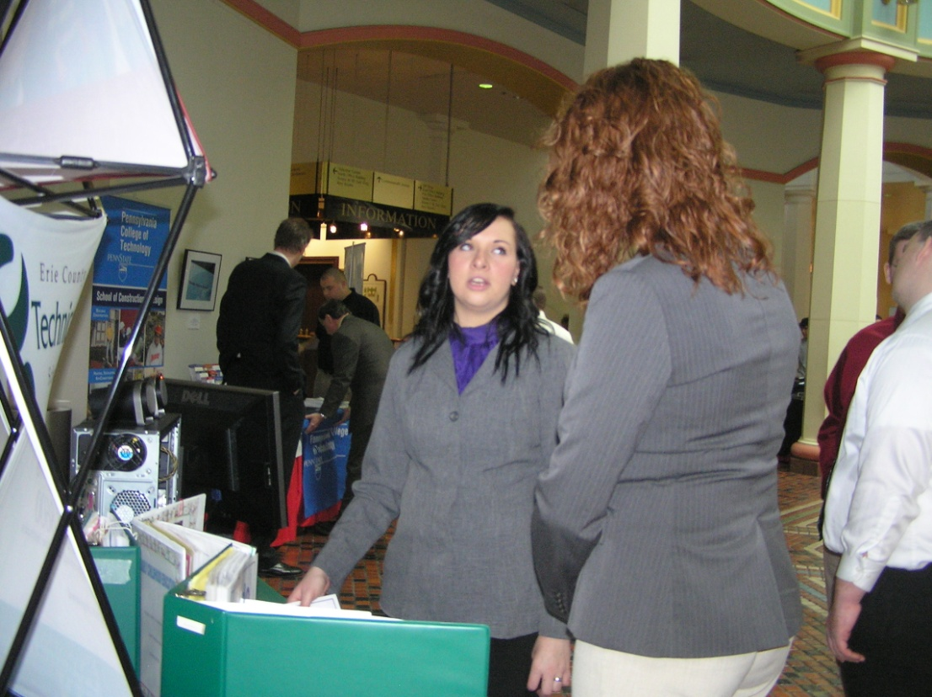
We also enjoyed speaking with Rep. Sonney’s Legislative Assistant, Christine Crone.

Slide 9
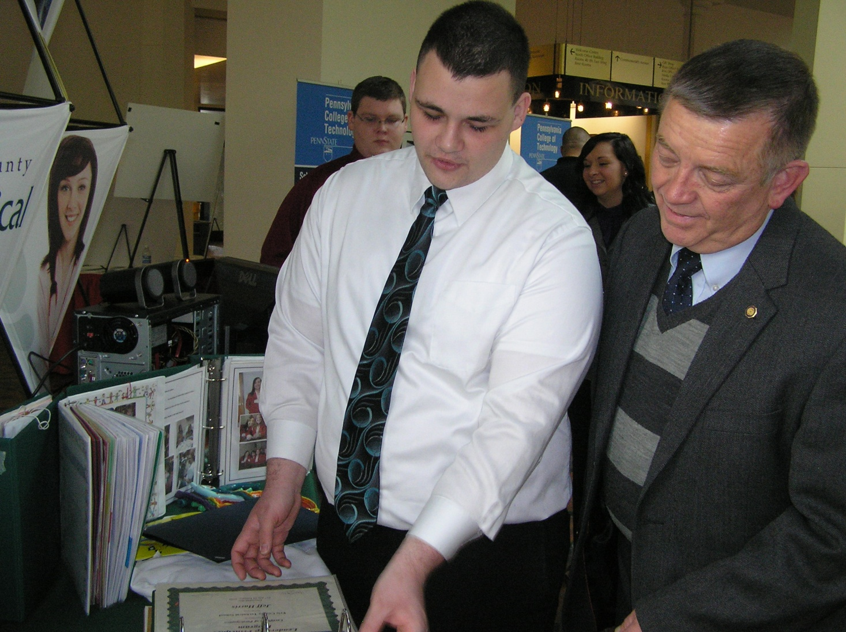
Meeting Rep. John Hornaman

Slide 10
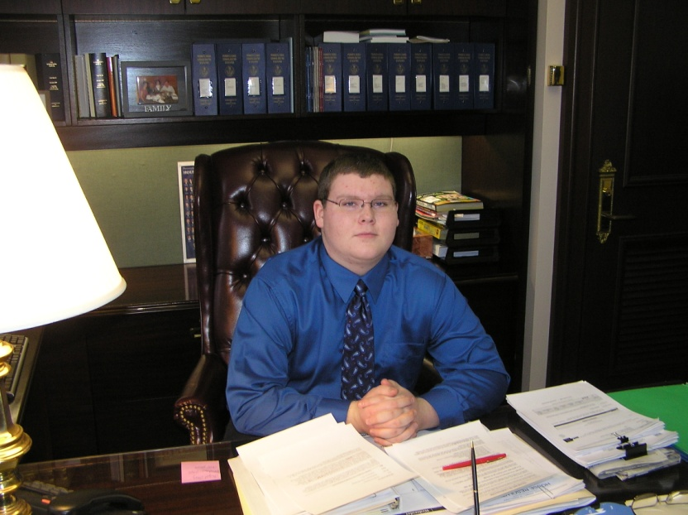
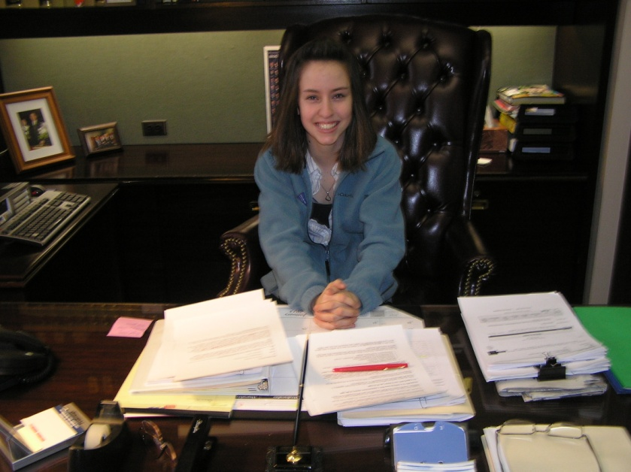
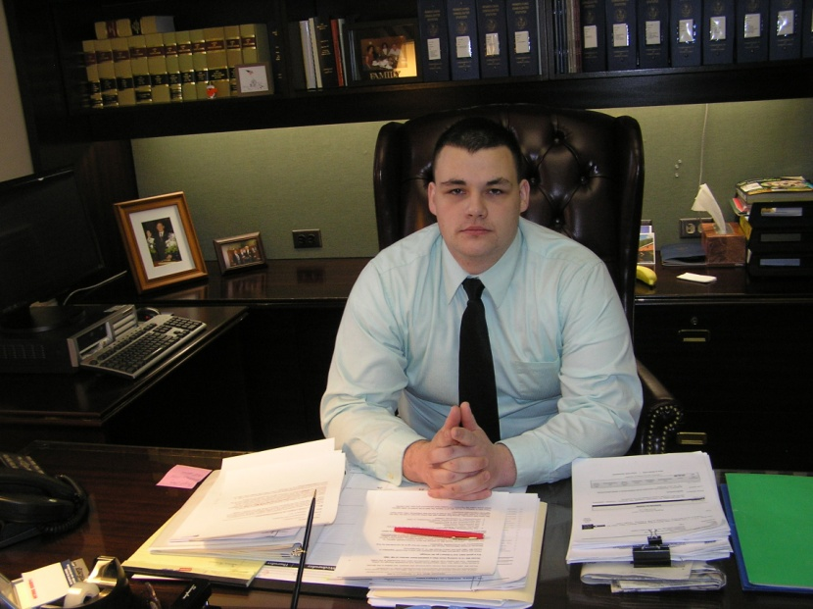
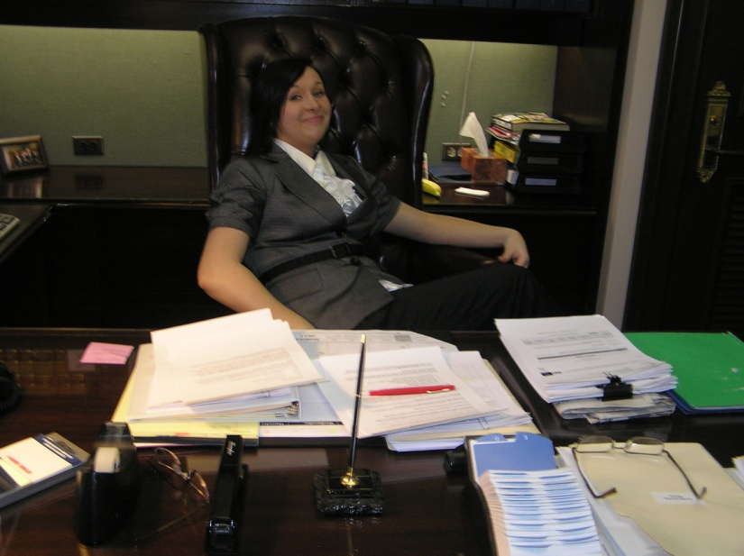
He needed our help, too.

Slide 11
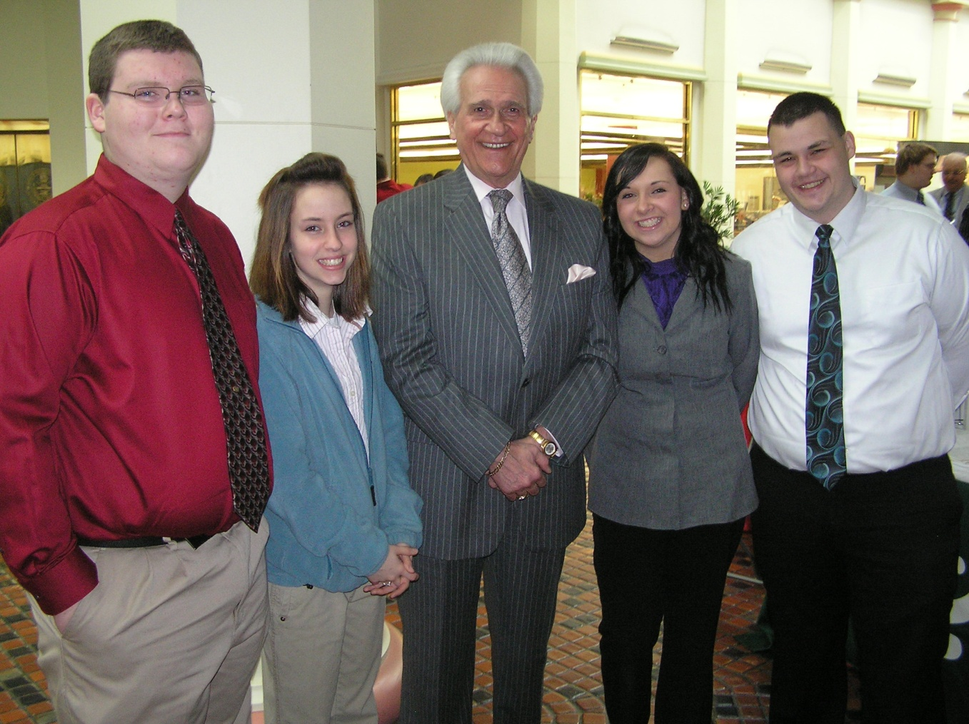
Meeting Rep. Flo Fabrizio

Slide 12
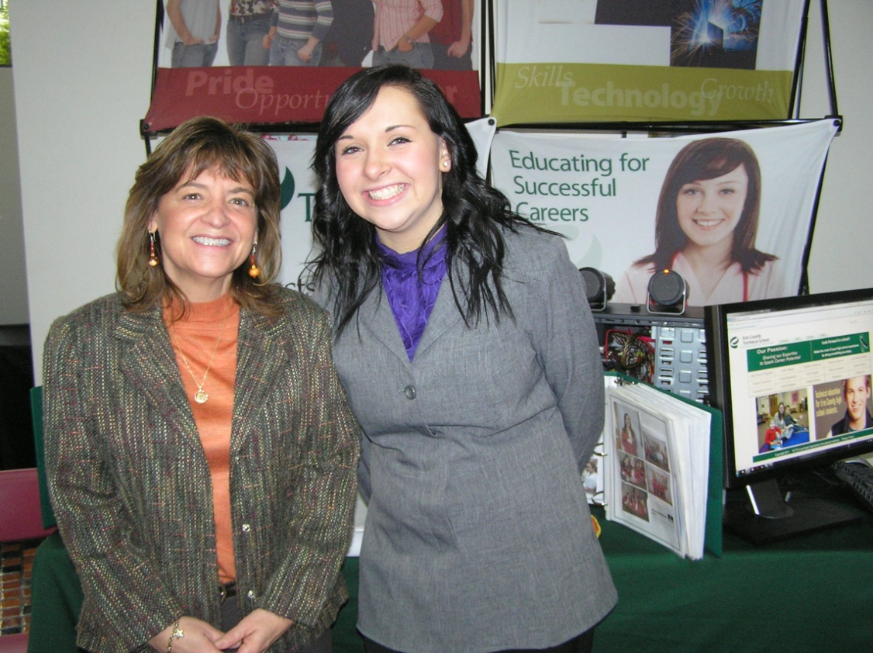
. . . And his Legislative Assistant, Denise Milus.

Slide 13
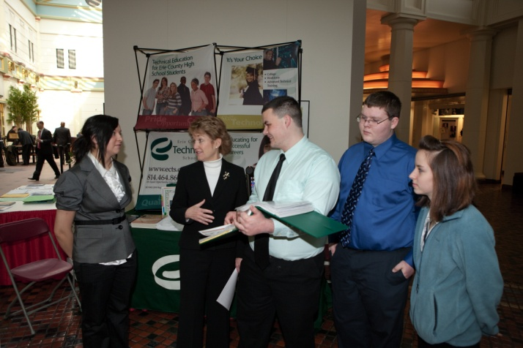
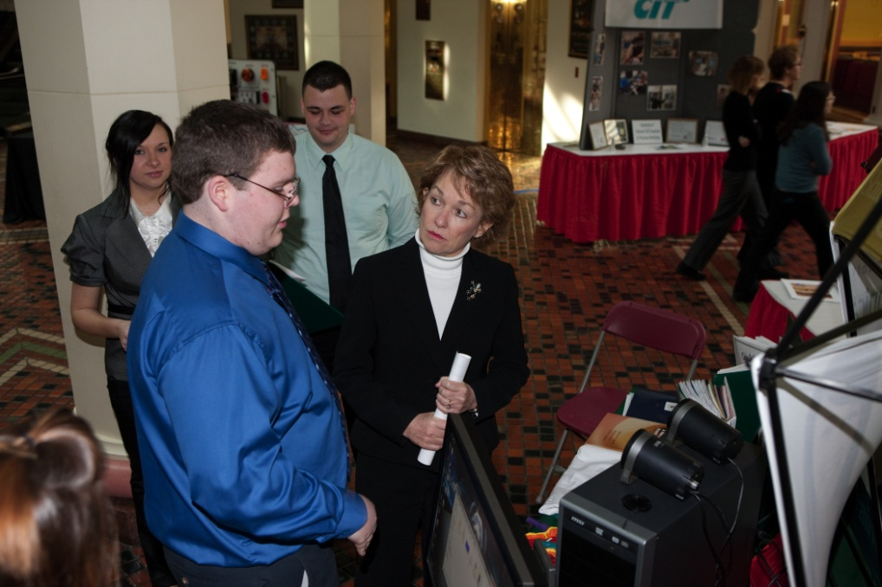
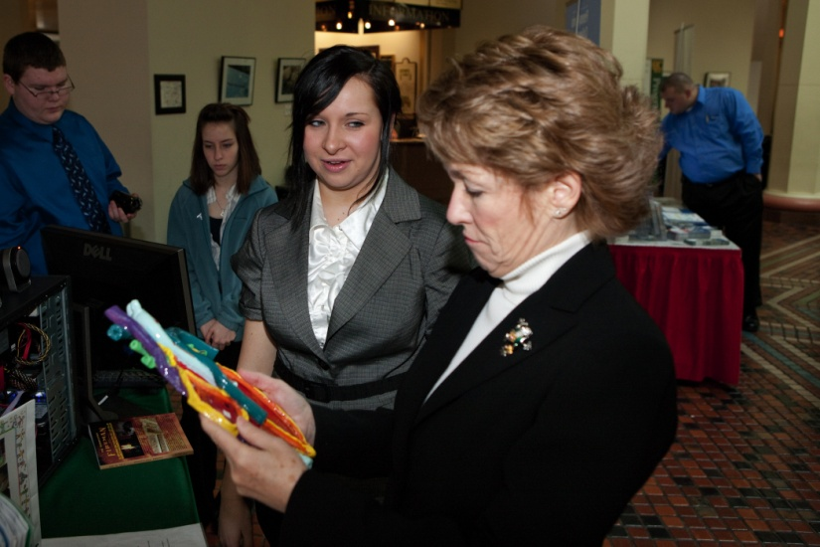
Meeting Sen. Jane Earll

Slide 14
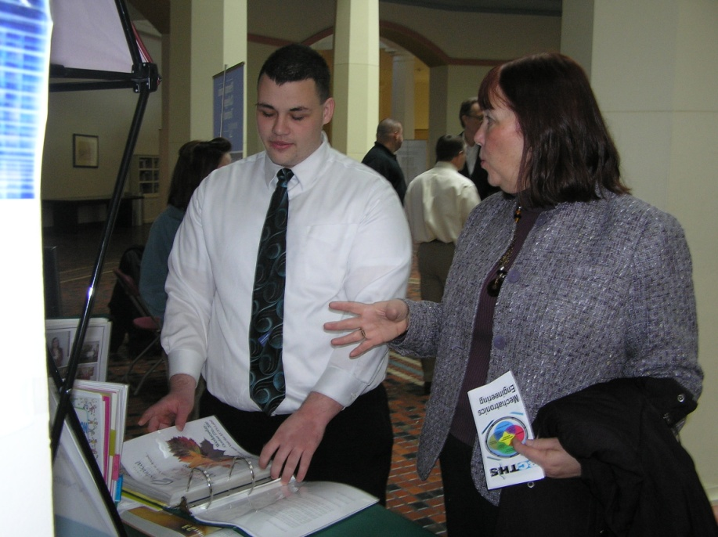
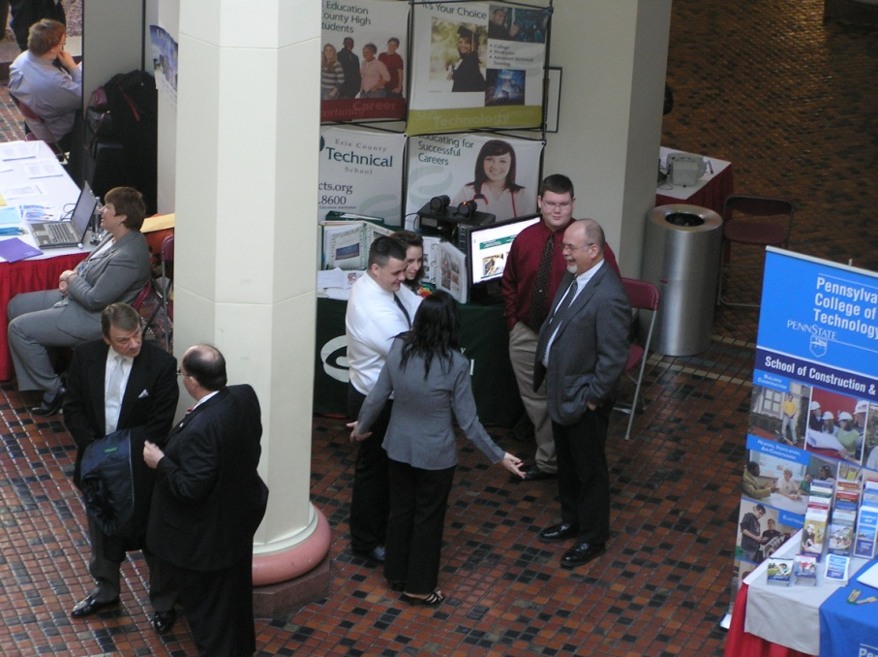
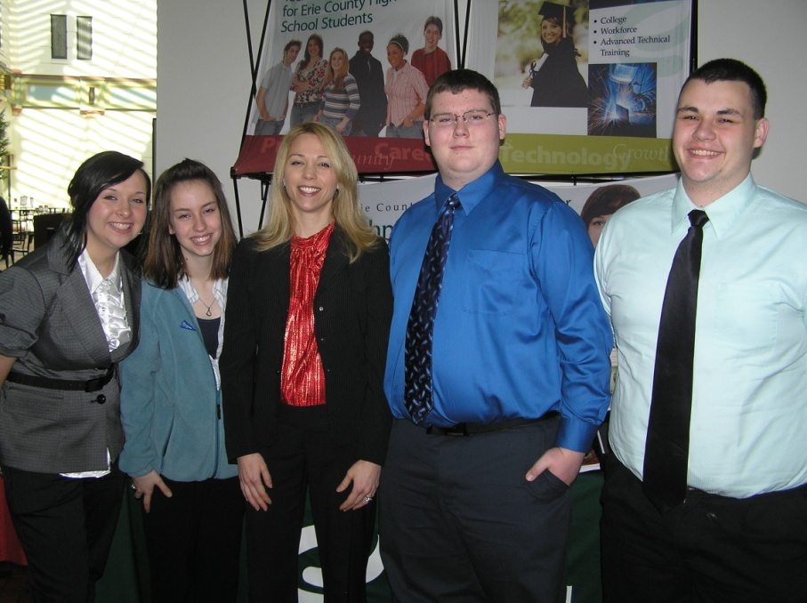
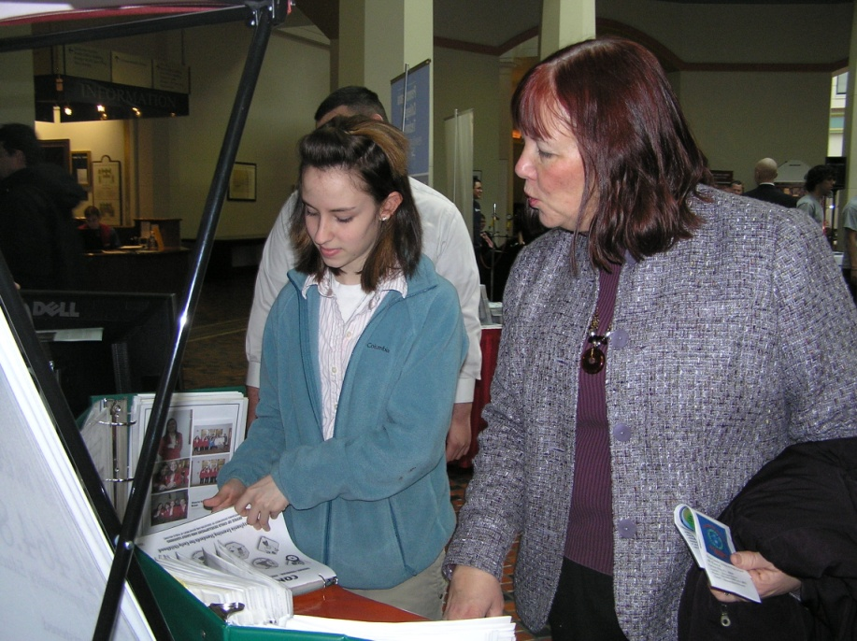
With Perkins PDE Coordinator Cynthia Gross and AYES Susan Doherty.

Slide 15
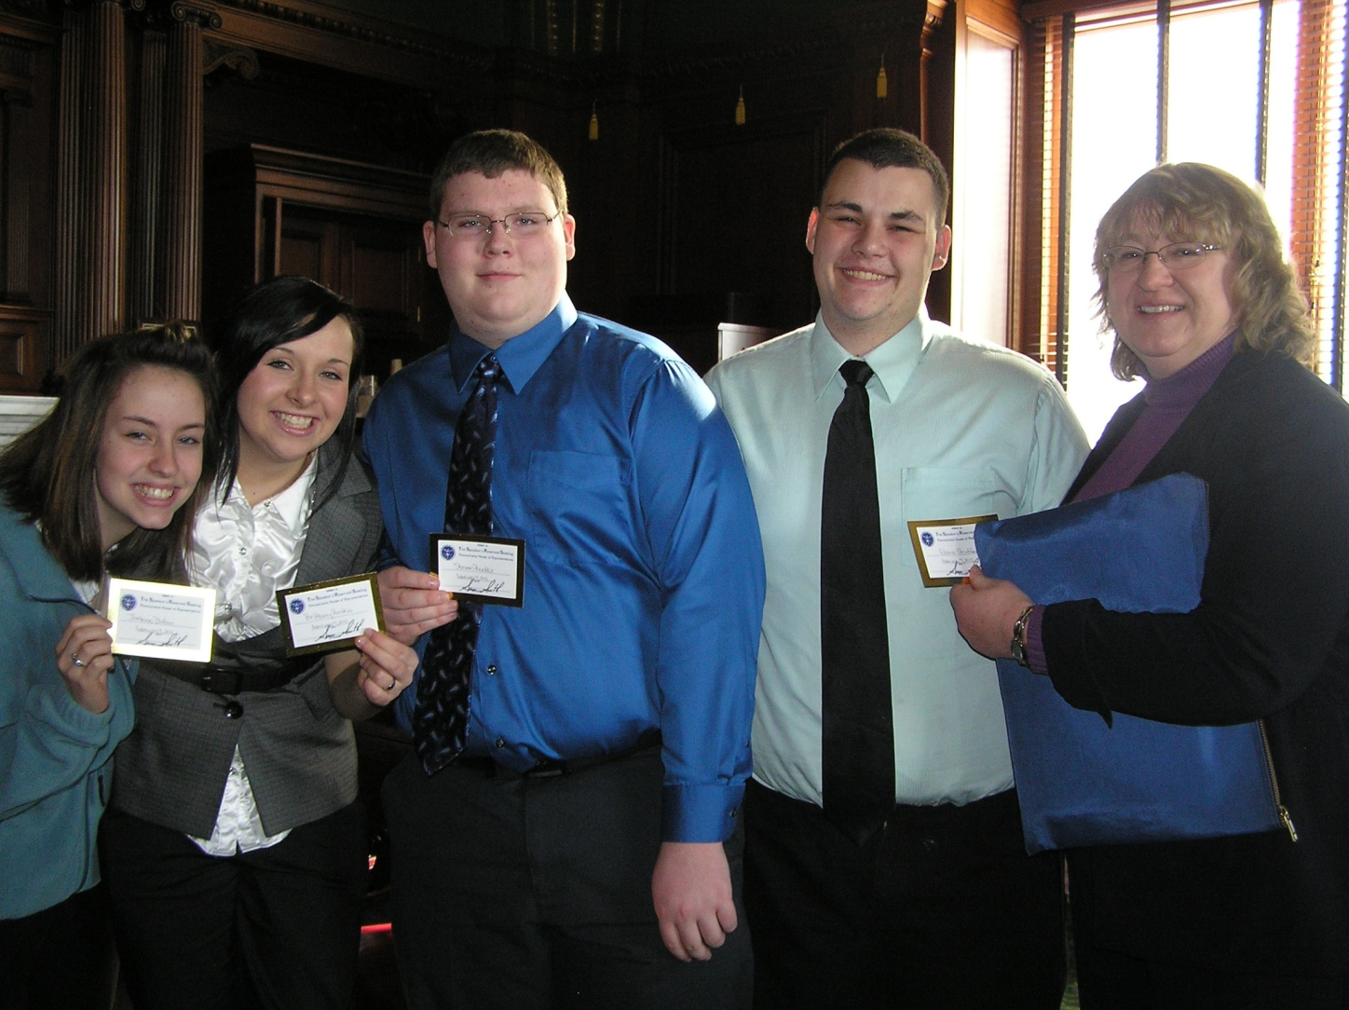
In the Speaker of the House’s reception chambers with our floor passes.

Slide 16
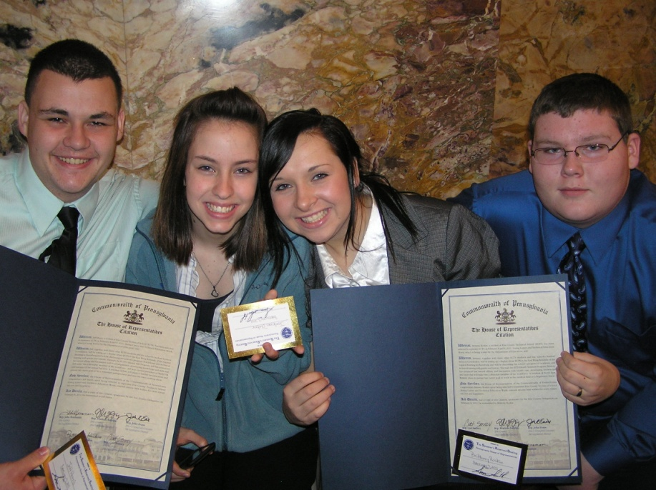
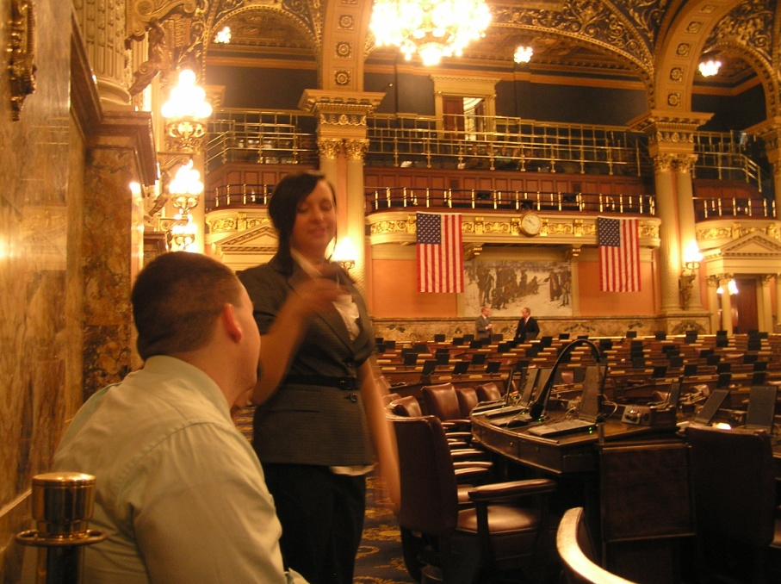
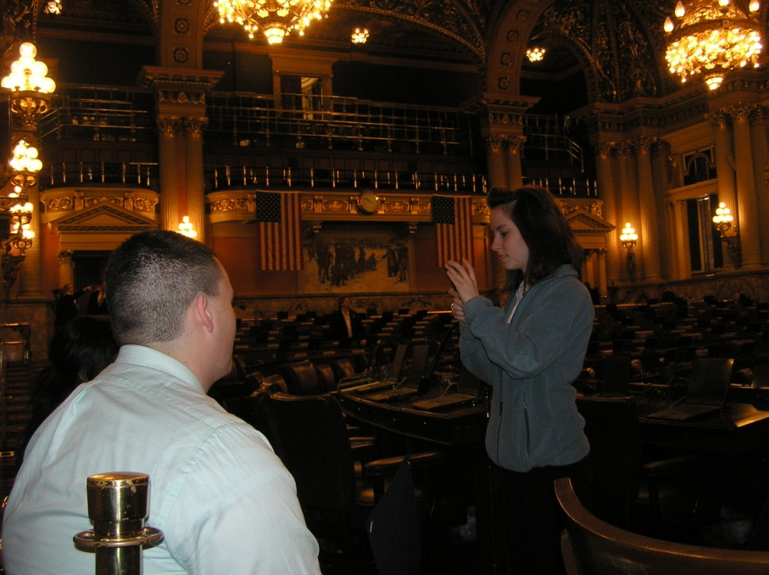
On the floor of the House of Representatives,
just prior to the start of session.

Slide 17
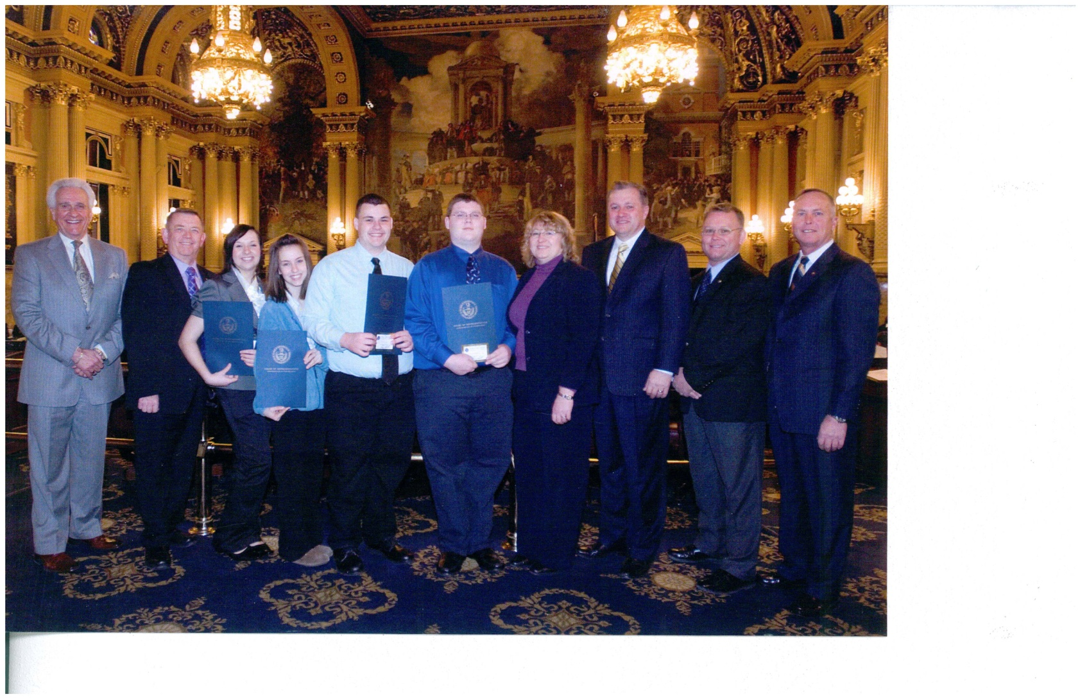
With the Erie Delegation
Representatives Flo Fabrizio, John Hornaman,
John Evans, Pat Harkins and Curt Sonney.

Slide 18
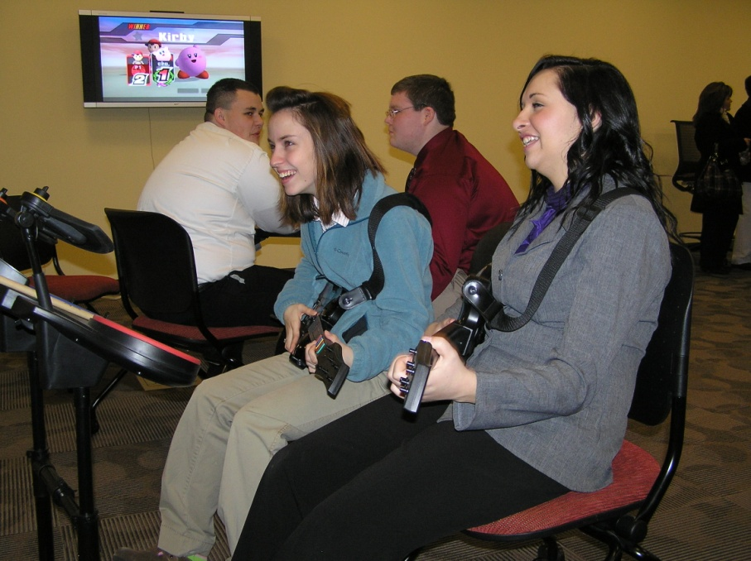
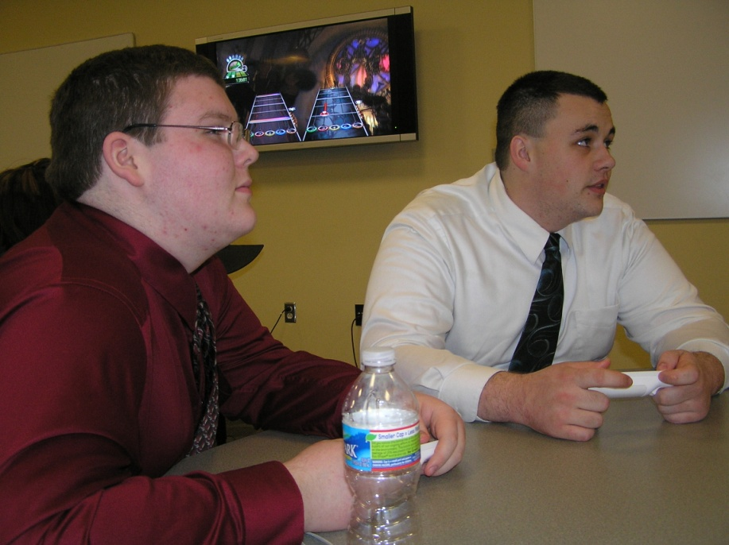
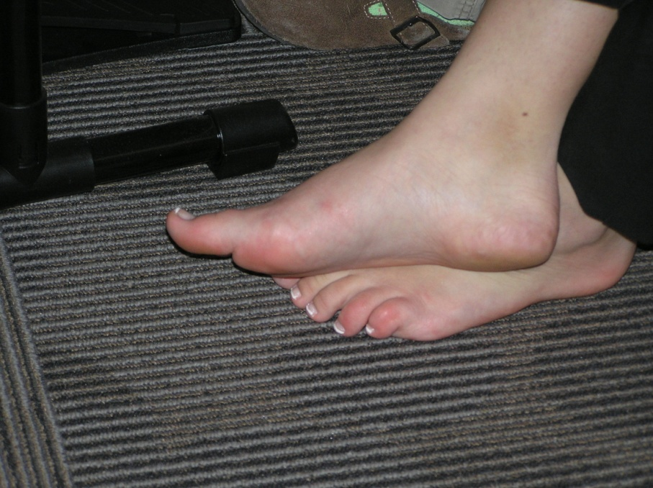
An evening to relax at the student reception hosted by Harrisburg University.

Slide 19
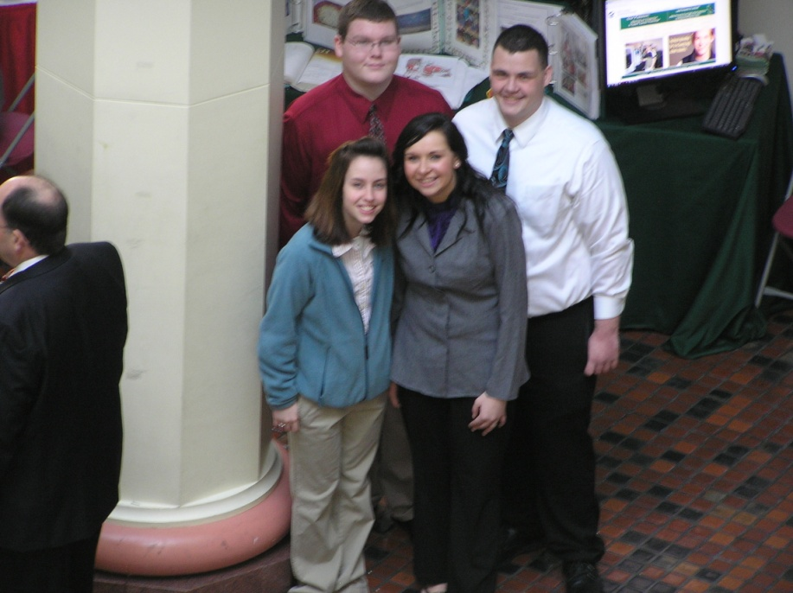
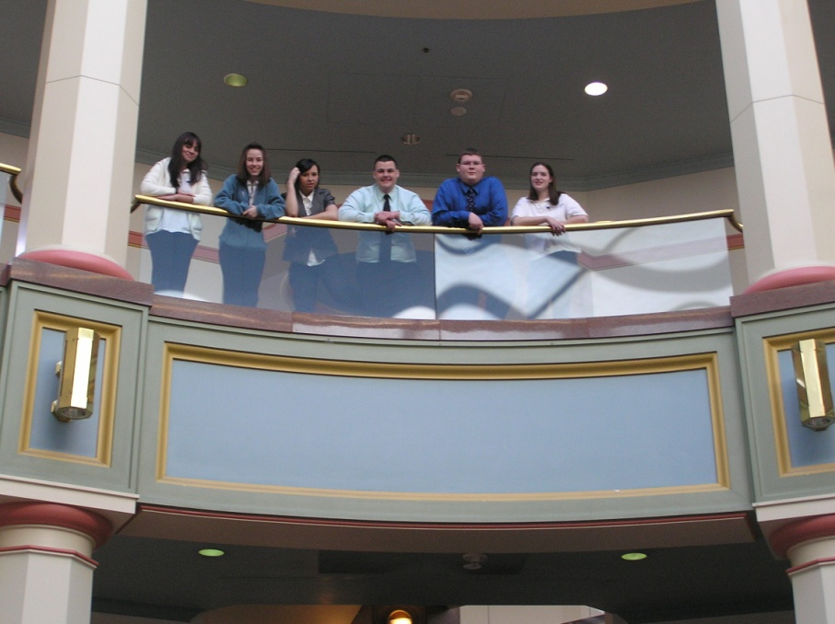
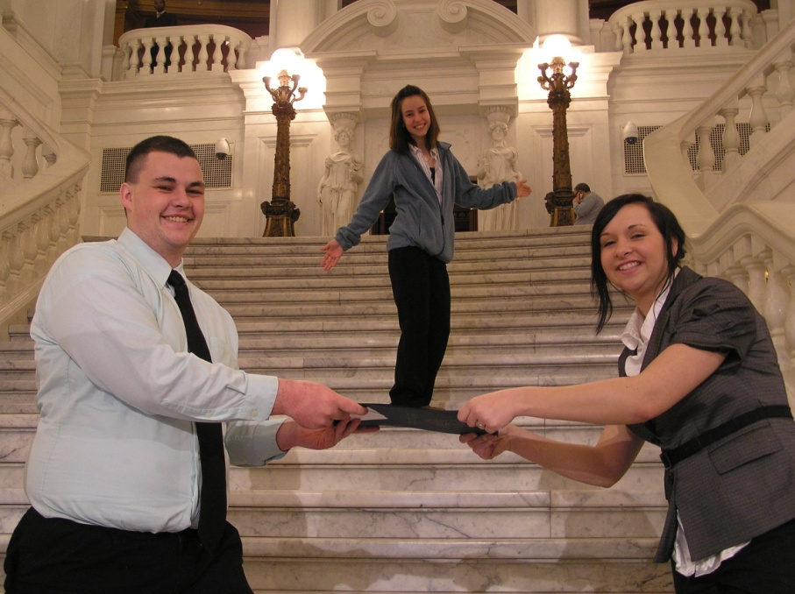
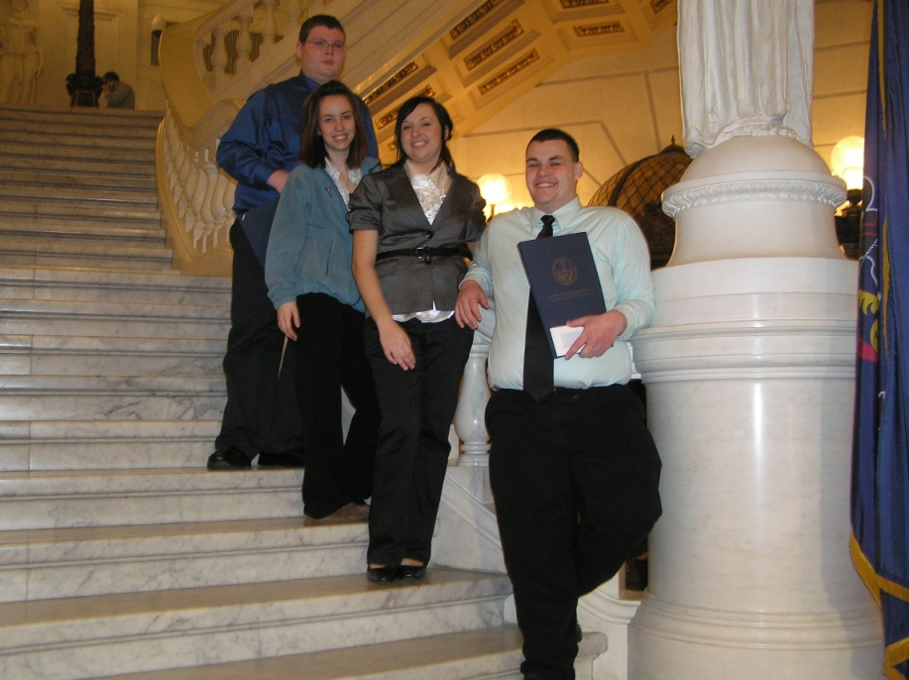

Slide 20
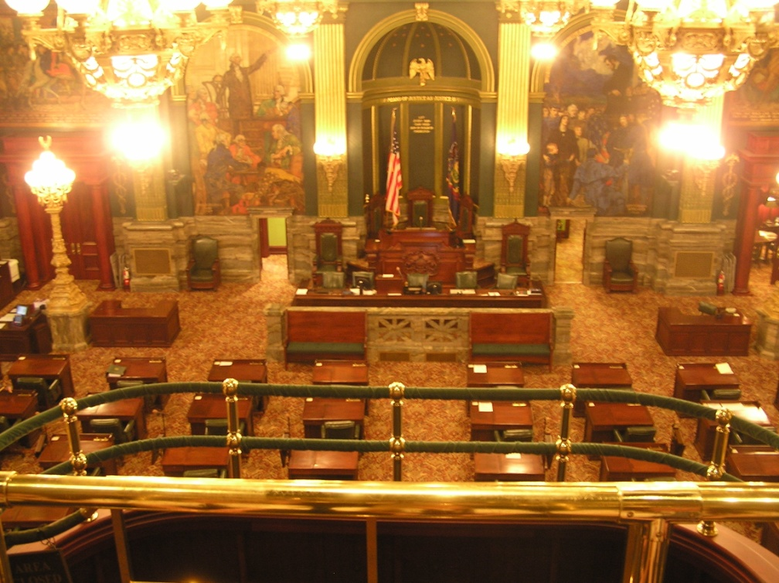
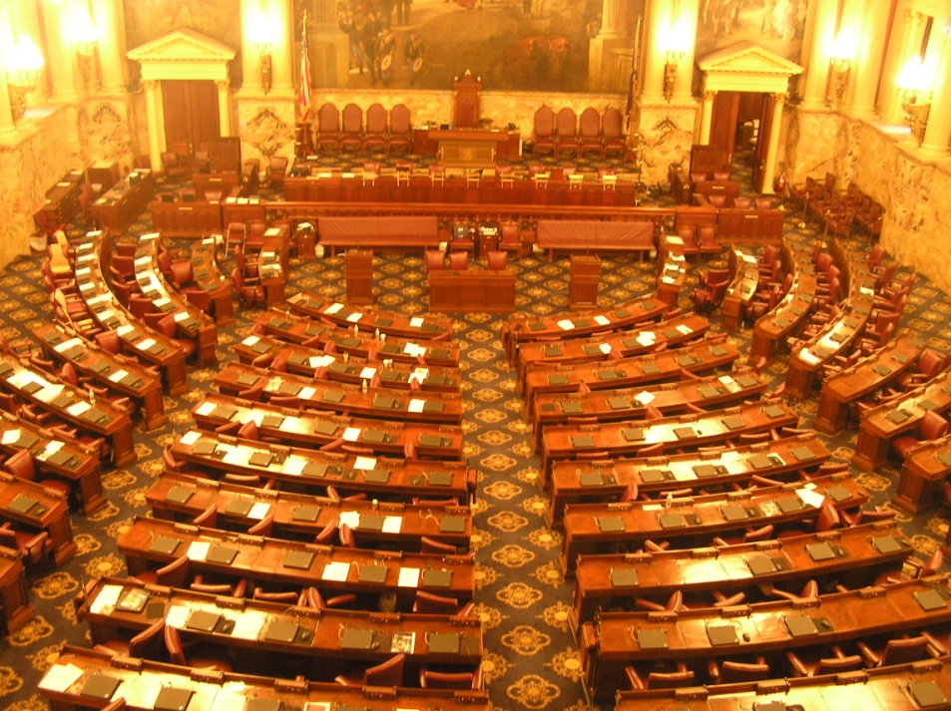
The PA Senate
The House of Representatives

Slide 21

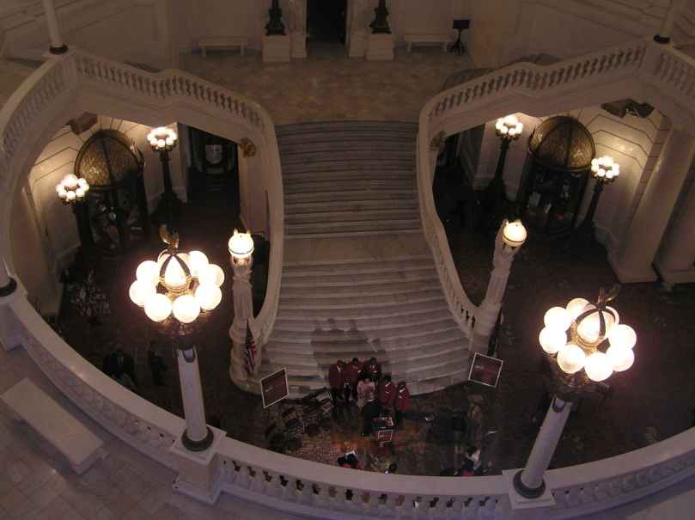
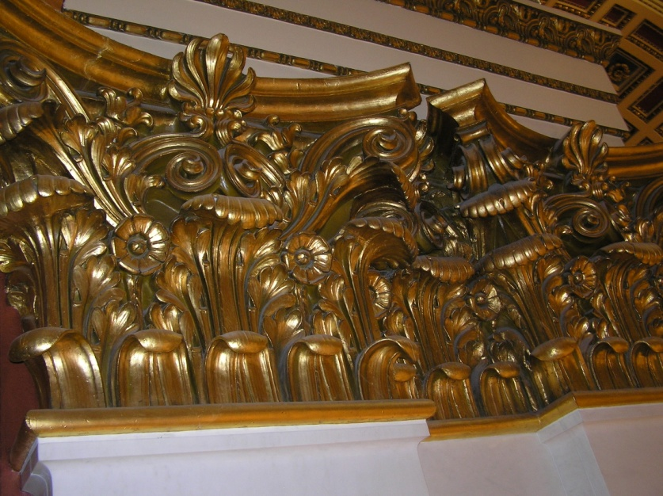
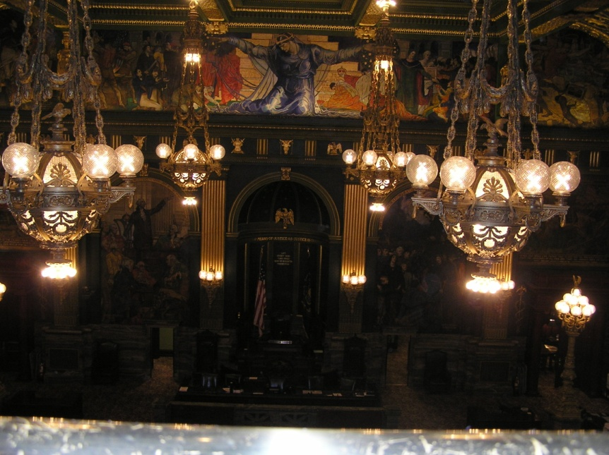
Capitol Building Architecture

Slide 22

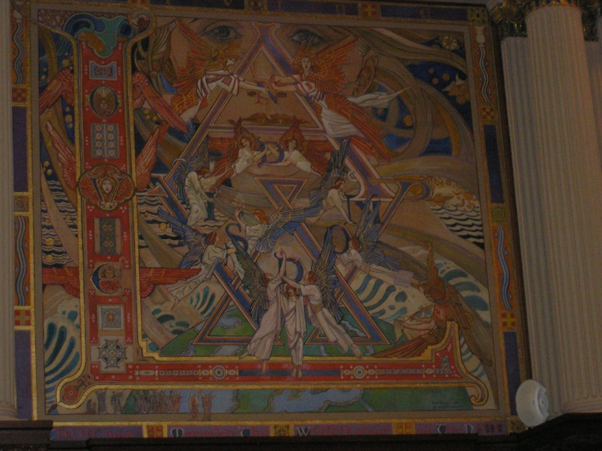

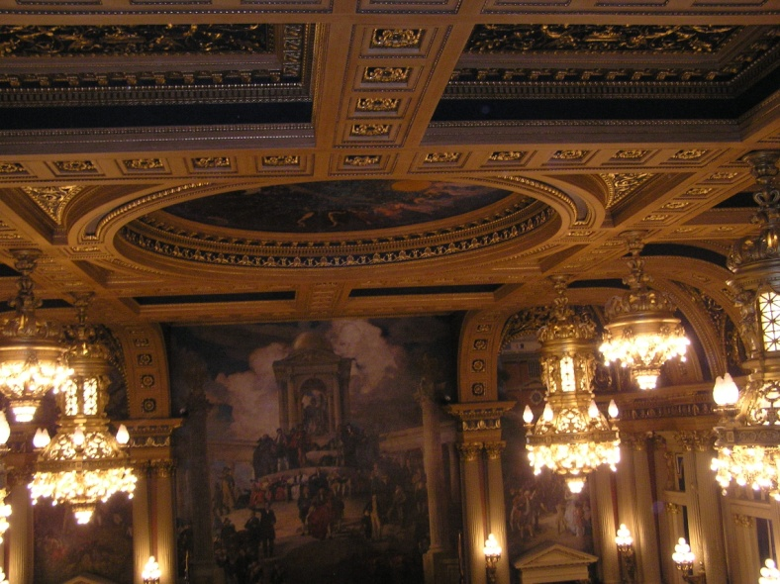
Capitol Building Architecture

Slide 23
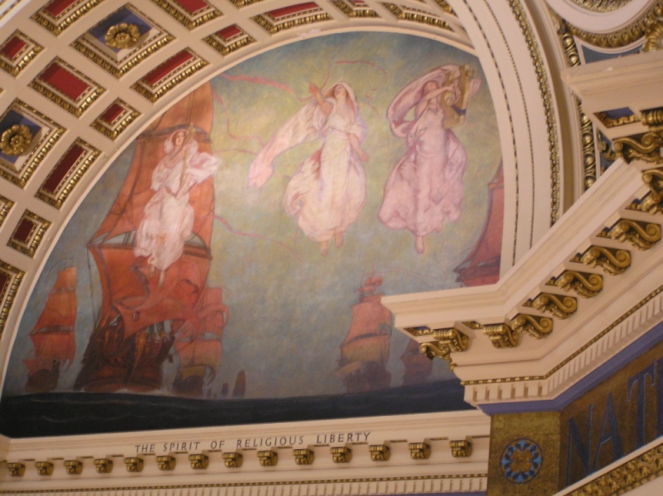
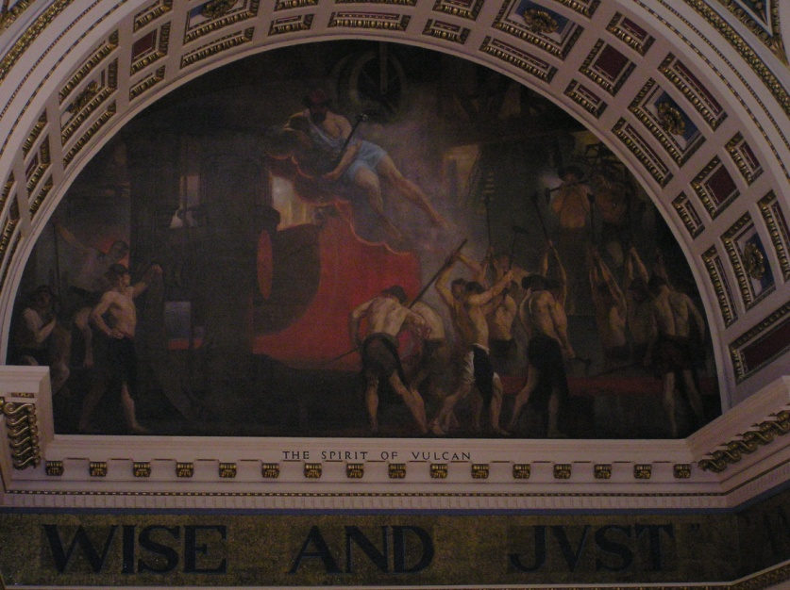
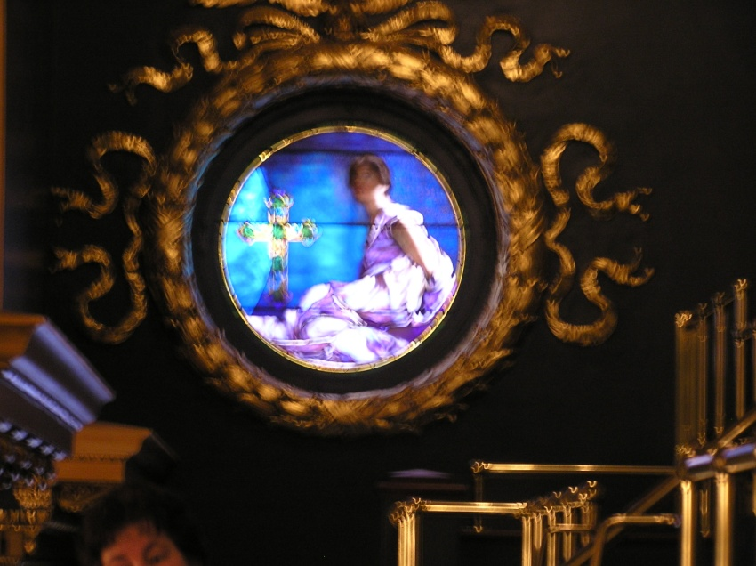
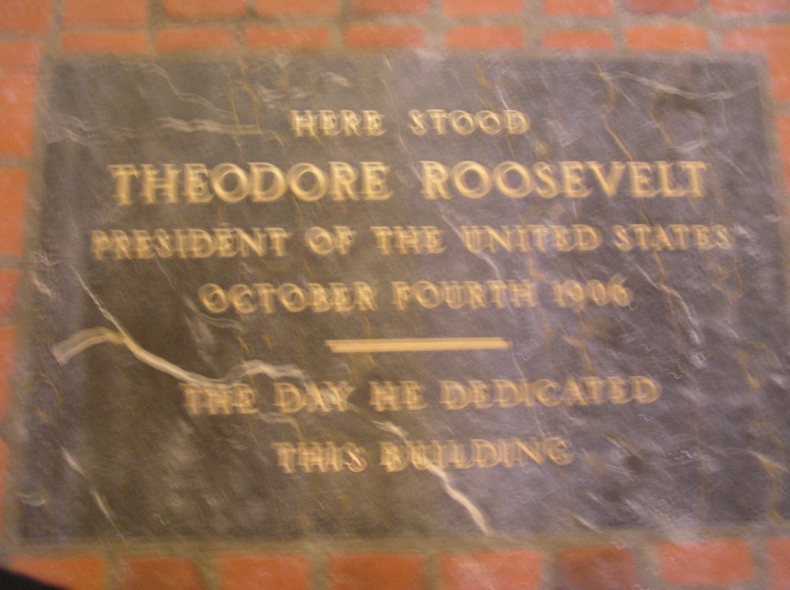
Capitol Building Architecture

Slide 24

Thanks for the Opportunity!

